Slide 1
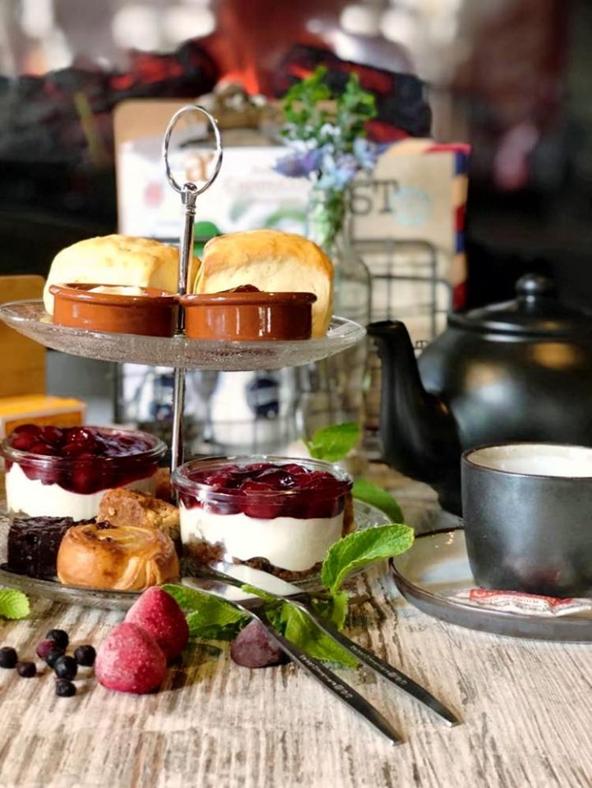
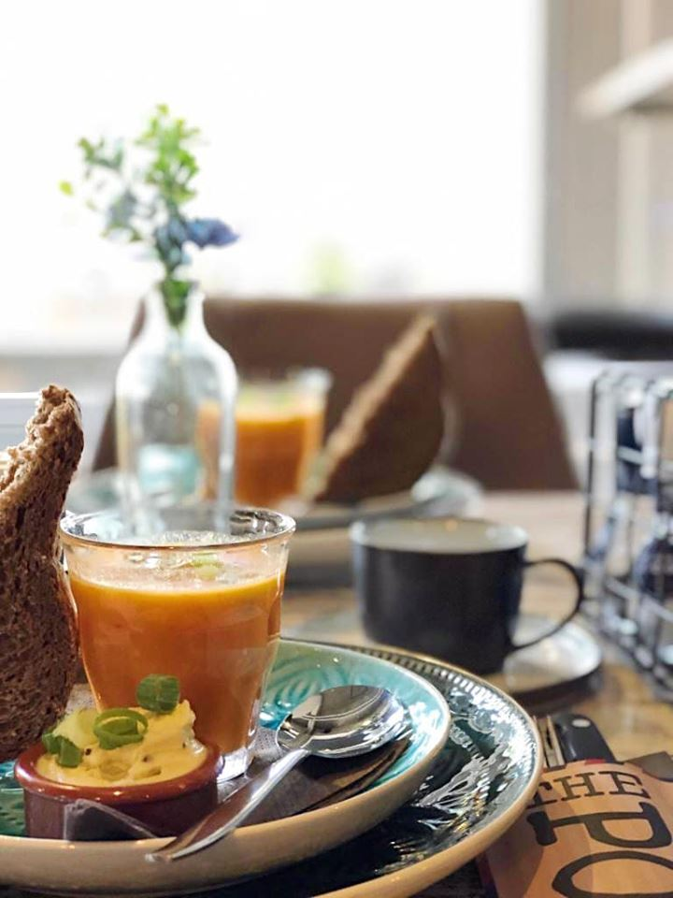
High tea – Lunchroom The Post
Lactosefree
Soup:
Curry coconut soup
Salad:
Warm chicken pieces with bacon, cucumber and truffle cream
Hearty: Wrap with smoked salmon, red onion, arugula and pesto mayonnaise
Carpaccio sandwich, arugula and truffle cream
Sweet:
Mini cake Mini muffin
Cookies
Cheesecake
Strawberry jam en cherries
Unlimited tea

